Slide 1
Chapters 4 & 11
Properties of Solutions

Slide 2
4.1 Water, the Common Solvent
4.2 The Nature of Aqueous Solutions: Strong and Weak Electrolytes
4.3 The Composition of Solutions
4.7 Stoichiometry of Precipitation Reactions

Slide 3
11.1 Solution Composition
11.3 Factors Affecting Solubility
11.8 Colloids

Slide 4
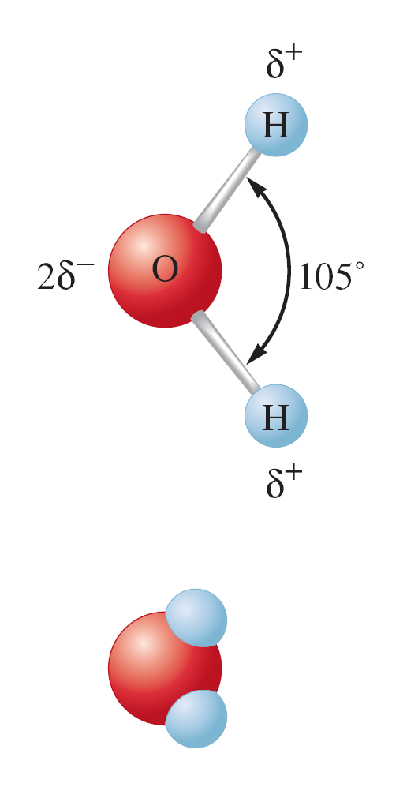
One of the most important substances on Earth.
Can dissolve many different substances.
A polar molecule because of its unequal charge distribution.

Slide 5
Dissolution of a Solid in a Liquid

Slide 6
Nature of Aqueous Solutions
Solute – substance being dissolved.
Solvent – liquid water.
Electrolyte – substance that when dissolved in water produces a solution that can conduct electricity.

Slide 7
Electrolytes
Strong Electrolytes – conduct current very efficiently (bulb shines brightly).
Weak Electrolytes – conduct only a small current (bulb glows dimly).
Nonelectrolytes – no current flows (bulb remains unlit).

Slide 8
Electrolyte Behavior

Slide 9
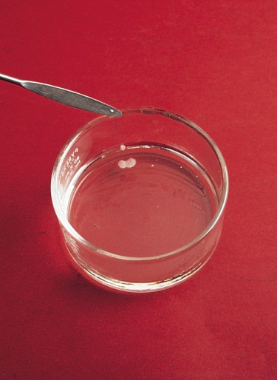
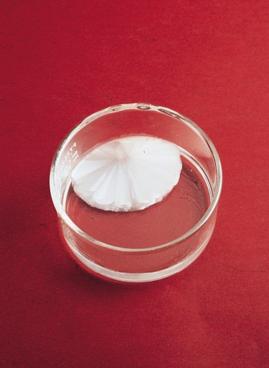
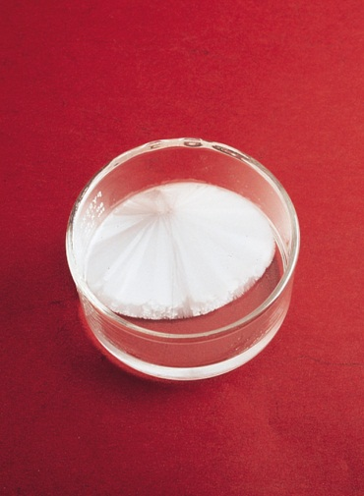
A saturated solution contains the maximum amount of a solute that will dissolve in a given solvent at a specific temperature.
An unsaturated solution contains less solute than the solvent has the capacity to dissolve at a specific temperature.
A supersaturated solution contains more solute than is present in a saturated solution at a specific temperature.
Sodium acetate crystals rapidly form when a seed crystal is
added to a supersaturated solution of sodium acetate.
12.1

Slide 10
“like dissolves like”
Two substances with similar intermolecular forces are likely to be soluble in each other.
non-polar molecules are soluble in non-polar solvents
    CCl₄ in C₆H₆
polar molecules are soluble in polar solvents
    C₂H₅OH in H₂O
ionic compounds are more soluble in polar solvents
    NaCl in H₂O or NH₃ (l)
12.2

Slide 11
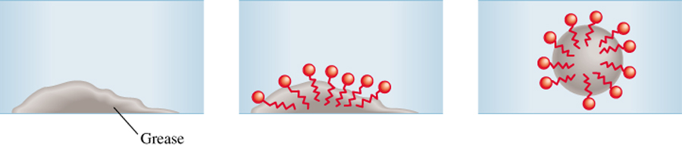
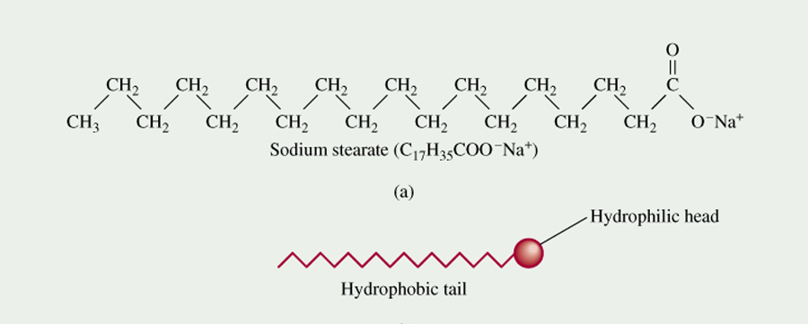
The Cleansing Action of Soap
12.8

Slide 12
Molarity
Molarity (M) = moles of solute per volume of solution in liters:

Slide 13

Exercise
A 500.0-g sample of potassium phosphate is dissolved in enough water to make 1.50 L of solution. What is the molarity of the solution?
1.57 M
Notes:
500.0 g is equivalent to 2.355 mol K₃PO₄ (500.0 g / 212.27 g/mol). The molarity is therefore 1.57 M (2.355 mol/1.50 L).

Slide 14
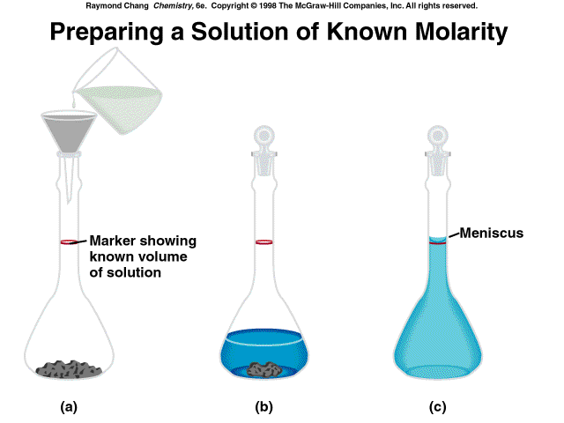
4.5

Slide 15
Concentration of Ions
For a 0.25 M CaCl₂ solution:
CaCl₂ → Ca²⁺ + 2Cl–
  Ca²⁺: 1 × 0.25 M = 0.25 M Ca²⁺
  Cl–: 2 × 0.25 M = 0.50 M Cl–.

Slide 16
Dilution
The process of adding water to a concentrated or stock solution to achieve the molarity desired for a particular solution.
Dilution with water does not alter the numbers of moles of solute present.
Moles of solute before dilution = moles of solute after dilution
M₁V₁ = M₂V₂

Slide 17
Exercise
What is the minimum volume of a 2.00 M NaOH solution needed to make 150.0 mL of a 0.800 M NaOH solution?
60.0 mL
Notes:
The minimum volume needed is 60.0 mL. M₁V₁ = M₂V₂ (2.00 M)(V₁) = (0.800 M)(150.0 mL)

Slide 18
Neutralization
Reaction between an acid and a base
Moles H⁺ = moles OH⁻ when neutralized
THIS MAY NOT BE A 1:1 RATIO!
  HCl vs NaOH 1 mole HCl = 1 mole NaOH
  H₂CO₃ vs NaOH 1 mole H₂CO₃ = 2 moles NaOH
Often done in titrations
M_{a} V_{a} = M_{b} V_{b} works IF 1:1… otherwise multiply one side by the ratio
Remember volumes ADD when solutions are mixed

Slide 19
Solving Stoichiometry Problems for Reactions in Solution
Identify the species present in the combined solution, and determine what reaction if any occurs.
Write the balanced net ionic equation for the reaction.
Calculate the moles of reactants.
Determine which reactant is limiting.
Calculate the moles of product(s), as required.
Convert to grams or other units, as required.

Slide 20

Concept Check (Part I)
10.0 mL of a 0.30 M sodium phosphate solution reacts with 20.0 mL of a 0.20 M lead(II) nitrate solution (assume no volume change).
  What precipitate will form?
  lead(II) phosphate, Pb₃(PO₄)₂
  What mass of precipitate will form?
1.1 g Pb₃(PO₄)₂
Notes:
The balanced molecular equation is: 2Na₃PO₄(aq) + 3Pb(NO₃)₂(aq) → 6NaNO₃(aq) + Pb₃(PO₄)₂(s).
0.0030 mol Na₃PO₄ present to start and 0.0040 mol Pb(NO₃)₂ present to start. Pb(NO₃)₂ is the limiting reactant, therefore 0.0013 mol of Pb₃(PO₄)₂ is produced. Since the molar mass of Pb₃(PO₄)₂ is 811.54 g/mol, 1.1 g of Pb₃(PO₄)₂ will form.

Slide 21
Let’s Think About It
Where are we going?
  To find the mass of solid Pb₃(PO₄)₂ formed.
How do we get there?
  What are the ions present in the combined solution?
  What is the balanced net ionic equation for the reaction?
  What are the moles of reactants present in the solution?
  Which reactant is limiting?
  What moles of Pb₃(PO₄)₂ will be formed?
  What mass of Pb₃(PO₄)₂ will be formed?

Slide 22
Various Types of Solutions
Example | State of Solution | State of Solute | State of Solvent
Air, natural gas | Gas | Gas | Gas
Mixtures of soft drinks, antifreeze | Liquid | Liquid | Liquid
Brass | Solid | Solid | Solid
Carbonated water (soda) | Liquid | Gas | Liquid
Seawater, sugar solution | Liquid | Solid | Liquid
Hydrogen in platinum | Solid | Gas | Solid

Slide 23
Structural Effects:
  Polarity & Surface area
Pressure Effects:
  Henry’s law
Temperature Effects:
  Affecting aqueous solutions

Slide 24
Pressure Effects
Henry’s law: C = kP
C = concentration of dissolved gas
k = constant
P = partial pressure of gas solute above the solution
Amount of gas dissolved in a solution is directly proportional to the pressure of the gas above the solution.

Slide 25
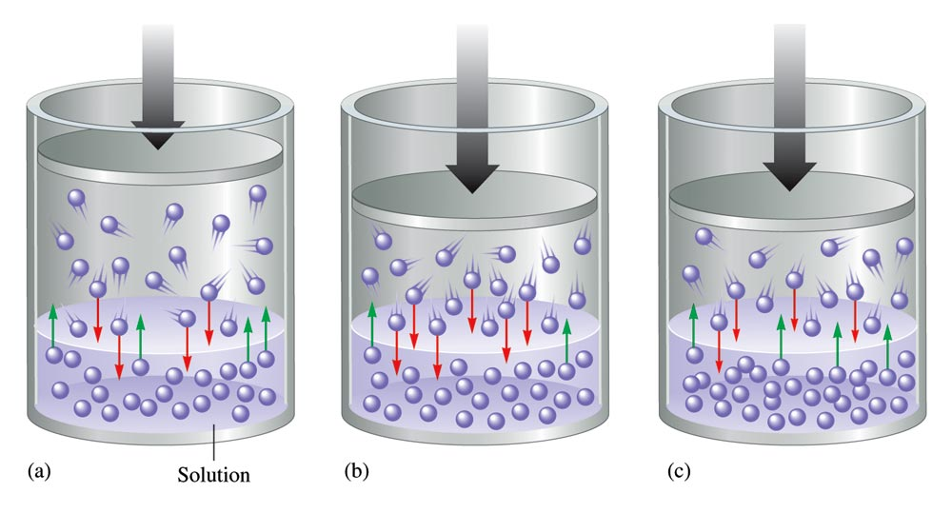
A Gaseous Solute

Slide 26
Temperature Effects (for Aqueous Solutions)
Although the solubility of most solids in water increases with temperature, the solubilities of some substances decrease with increasing temperature.
Predicting temperature dependence of solubility is very difficult.
Solubility of a gas in solvent typically decreases with increasing temperature.

Slide 27
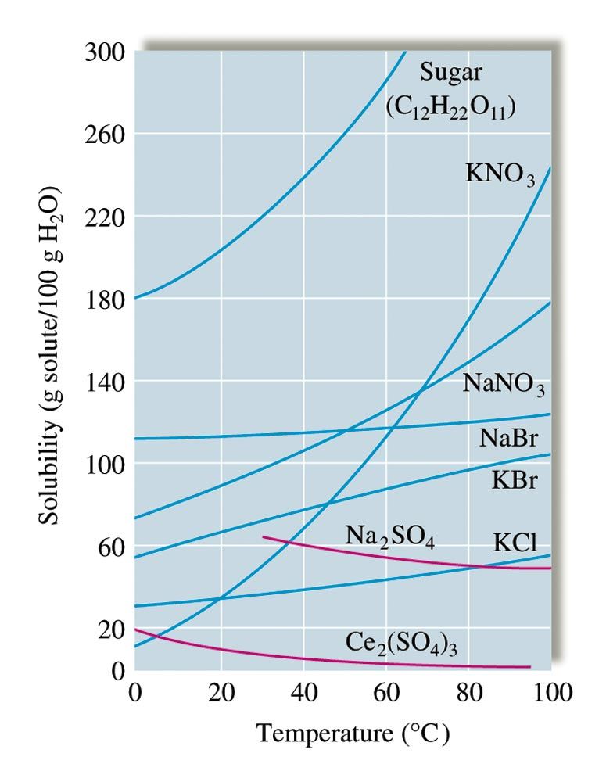
The Solubilities of Several Solids as a Function of Temperature

Slide 28
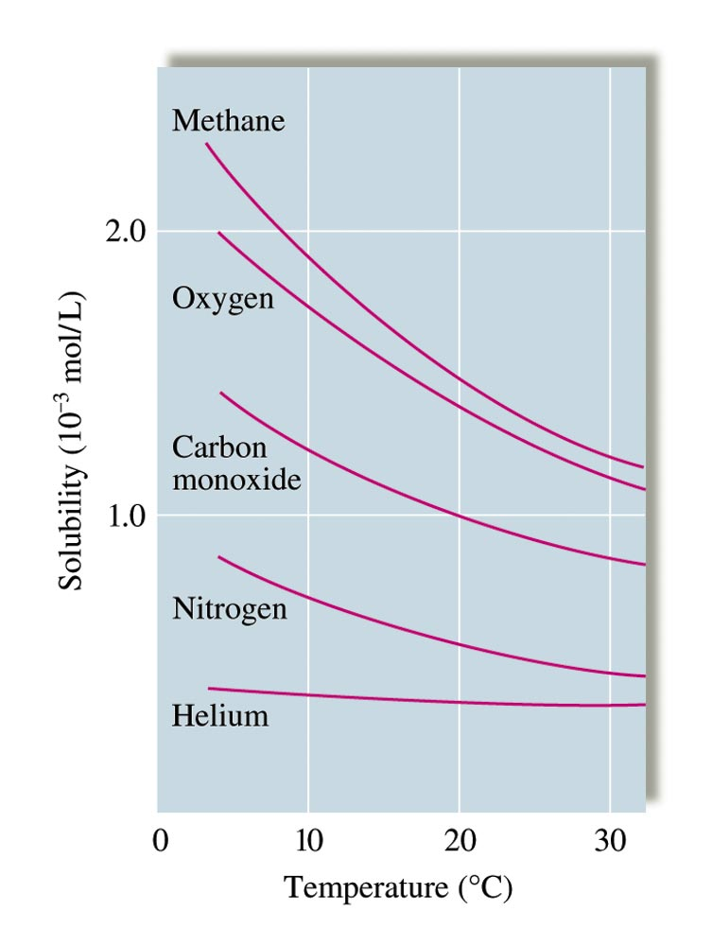
The Solubilities of Several Gases in Water

Slide 29
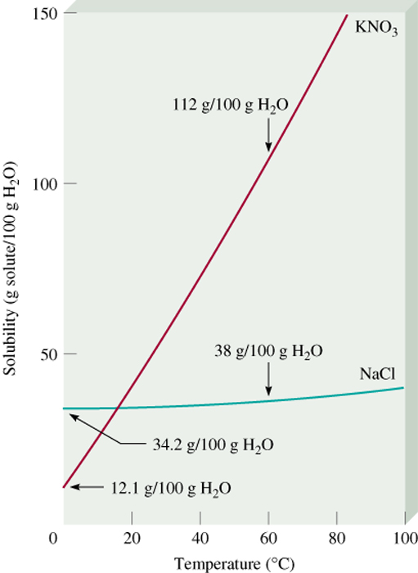
Fractional crystallization is the separation of a mixture of substances into pure components on the basis of their differing solubilities.
Suppose you have 90 g KNO₃ contaminated with 10 g NaCl.
Fractional crystallization:
Dissolve sample in 100 mL of water at 600C
Cool solution to 00C
All NaCl will stay in solution (s = 34.2g/100g)
78 g of PURE KNO₃ will precipitate (s = 12 g/100g). 90 g – 12 g = 78 g
12.4

Slide 30
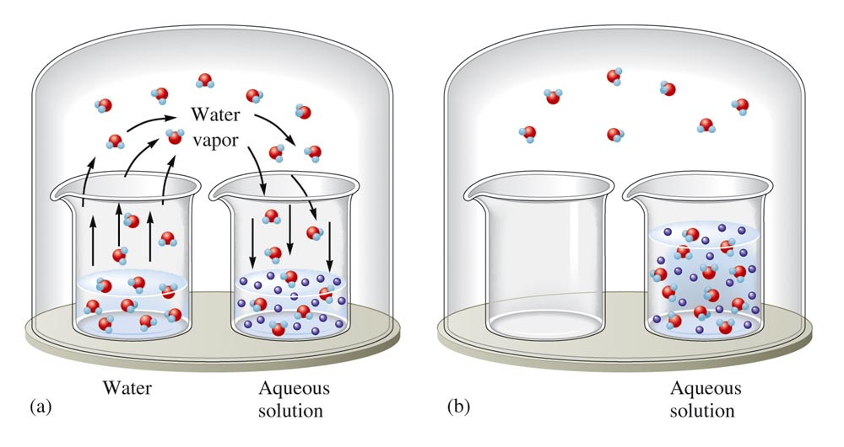
An Aqueous Solution and Pure Water in a Closed Environment

Slide 31
Liquid/Vapor Equilibrium

Slide 32
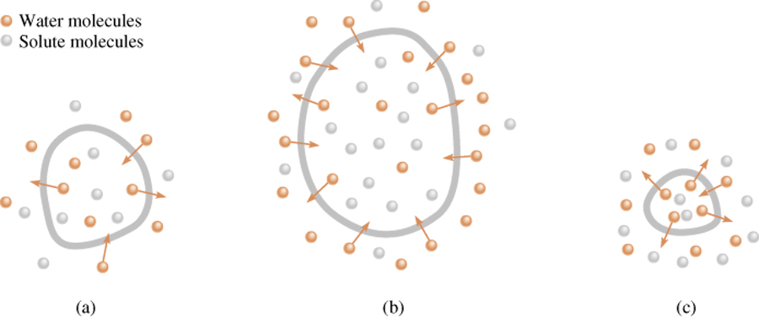
A cell in an:
isotonic
solution
hypotonic
solution
hypertonic
solution
12.6

Slide 33
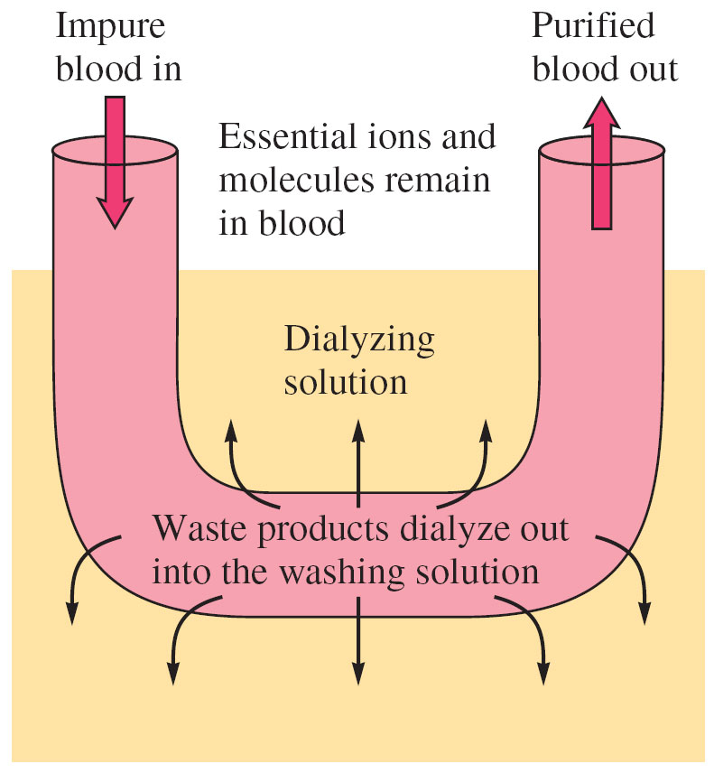
Figure 11.19: Diagram of
Artificial Kidney

Slide 34
A suspension of tiny particles in some medium.
Tyndall effect – scattering of light by particles.
Suspended particles in a colloid are single large molecules or aggregates of molecules or ions ranging in size from 1 to 1000 nm.
Suspension particles are over 1000 nm

Slide 35
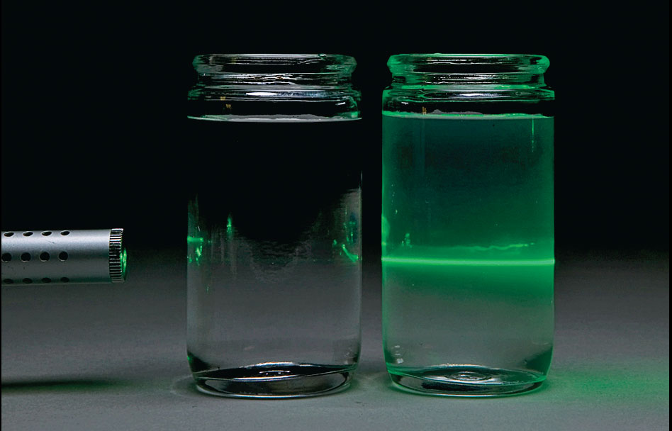
Figure 11.23: The Tyndall Effect
Photo © Brooks/Cole, Cengage Learning. Company. All rights reserved.

Slide 36
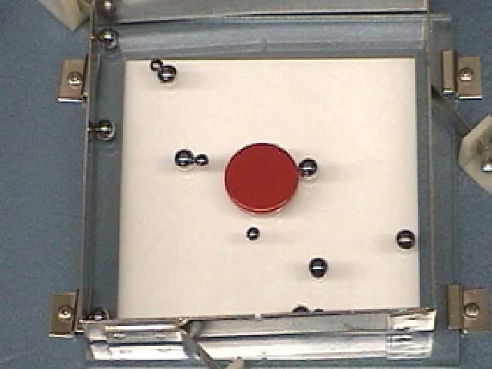

Colloids
Brownian motion
Tyndall Effect

Slide 37
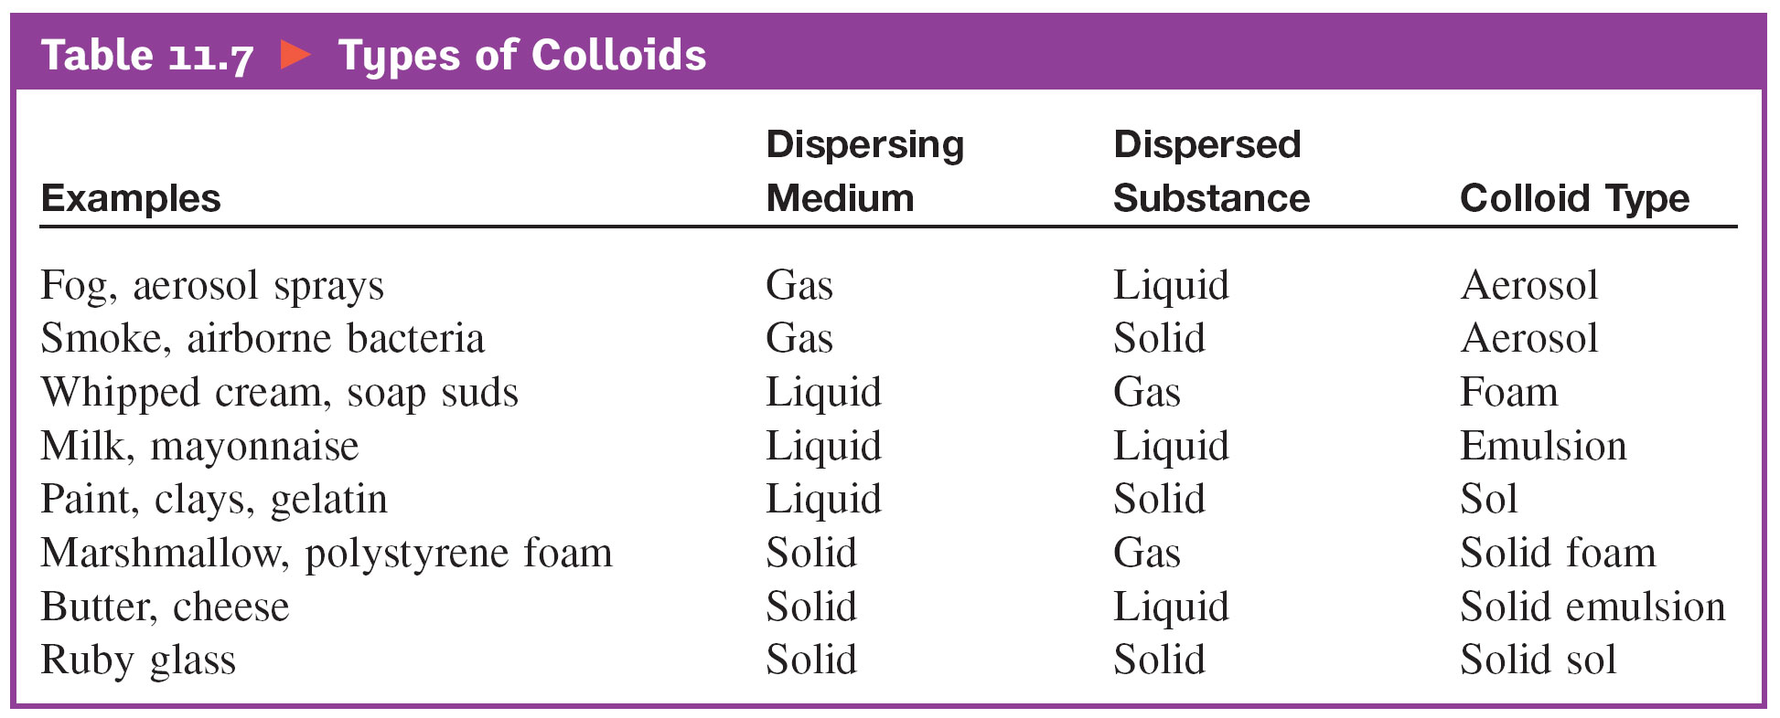
Types of Colloids

Slide 38
Coagulation
Destruction of a colloid.
Usually accomplished either by heating or by adding an electrolyte.

